Slide 1
Building Windows Forms Application

Slide 2
Objectives
Overview Windows Forms (WinForm)
Explain about type Controls and Components in WinForm
Working with Common Controls: Label, TextBox, MaskedTextBox,etc
Working with Menu, ProgressBar and Timer in WinForm
Explain about Position and Layout in WinForm
Demo create Windows Forms Application
Demo creating and using Menu in WinForm
Demo create MDI Application in WinForm

Slide 3
Overview Windows Forms

Slide 4
Introduction to Windows Forms
Windows Forms is a UI framework for building desktop apps. It provides one of the most productive ways to create desktop apps based on the visual designer provided in Visual Studio
With Windows Forms, we develop graphically rich apps that are easy to deploy, update, and work while offline or while connected to the internet
Windows Forms apps can access the local hardware and file system of the computer where the app is running
Windows Forms has rich UI controls that emulate features in high-end apps like Microsoft Office
Functionality such as drag-and-drop placement of visual controls makes it easy to build desktop apps

Slide 5
Introduction to Windows Forms
The Windows Forms development platform supports a broad set of app development features, including controls, graphics, data binding, and user input
Windows Forms features a drag-and-drop visual designer in Visual Studio to easily create Windows Forms apps
Windows Forms is a UI technology for .NET, a set of managed libraries that simplify common app tasks such as reading and writing to the file system
When we use a development environment like Visual Studio, we can create Windows Forms smart-client apps that display information, request input from users, and communicate with remote computers over a network

Slide 6
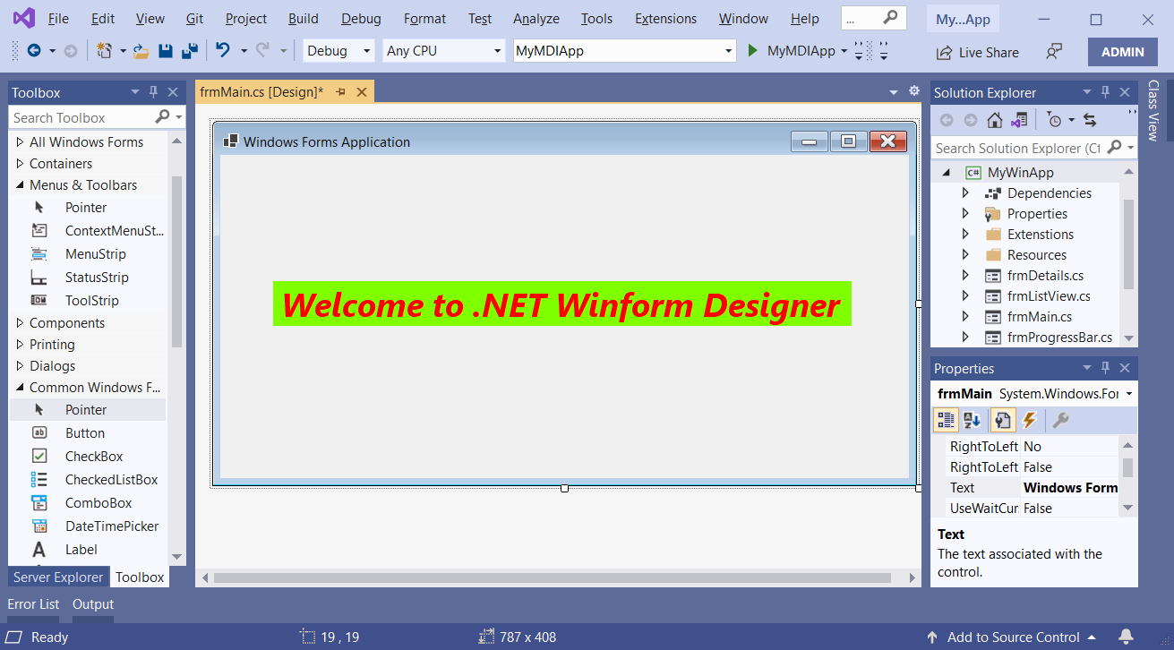

Slide 7
Introduction to Windows Forms
Click one deployment
Application setting
New Windows Forms controls
New Data Binding model
Rich graphics
Create App with least operation
Store global data to reuse anywhere
ToolStrip, MenuStrip, ProgressBar, etc.
Powerfull way to link control with data source ( BindingSource component )
GDI+ : drawing and painting image on forms

Slide 8
Create WinForm Application Demonstration

Slide 9
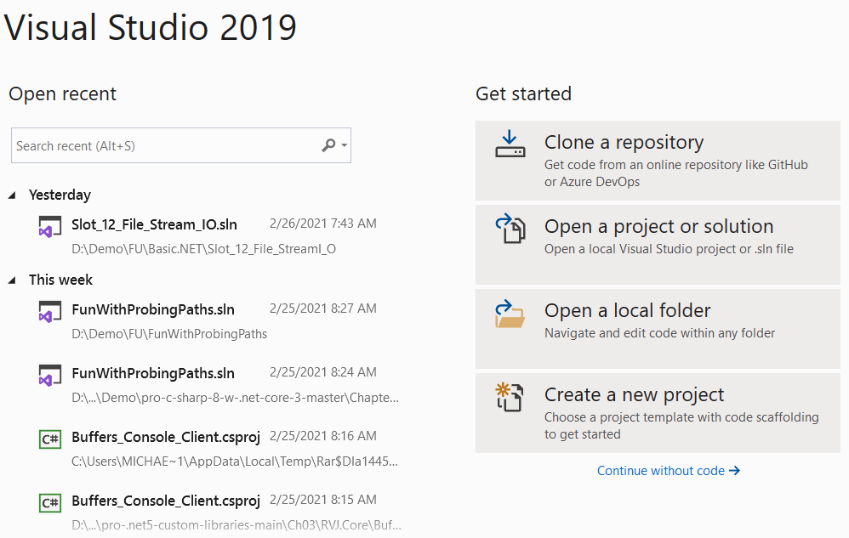
Open Visual Studio
Select Create a new project

Slide 10
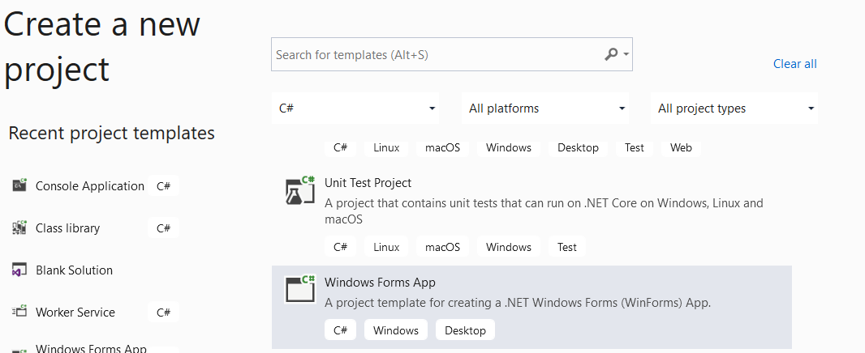
In the Search for templates box, type winforms, and then press Enter
In the code language dropdown, choose C#
In the templates list, select Windows Forms App(.NET) and then click Next

Slide 11
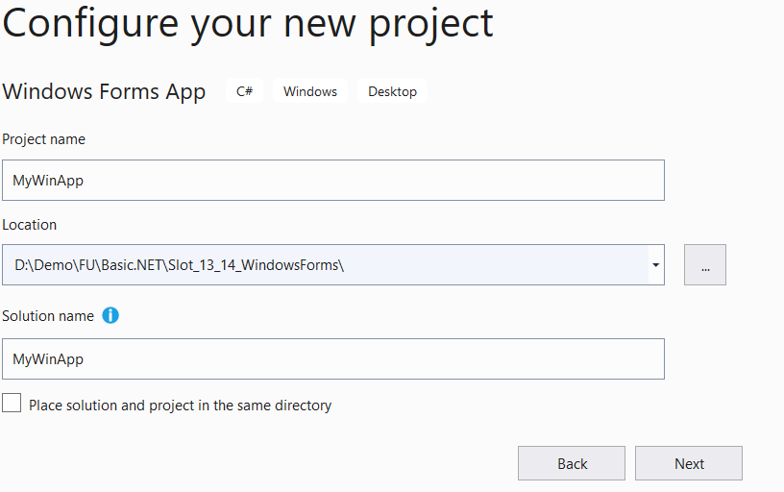
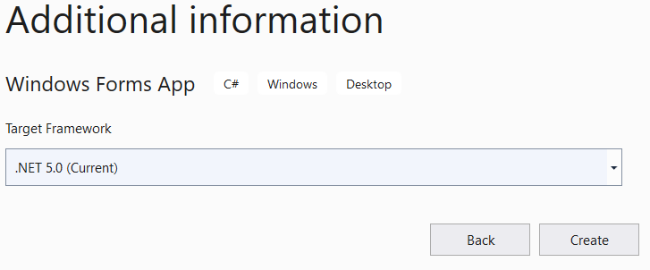
In the Configure your new project window, set the Project name to MyWinApp and click Next (save project to a folder by adjusting the Location setting)
In the Additional information window, select Target Framework to .NET 5.0 and click Create

Slide 12
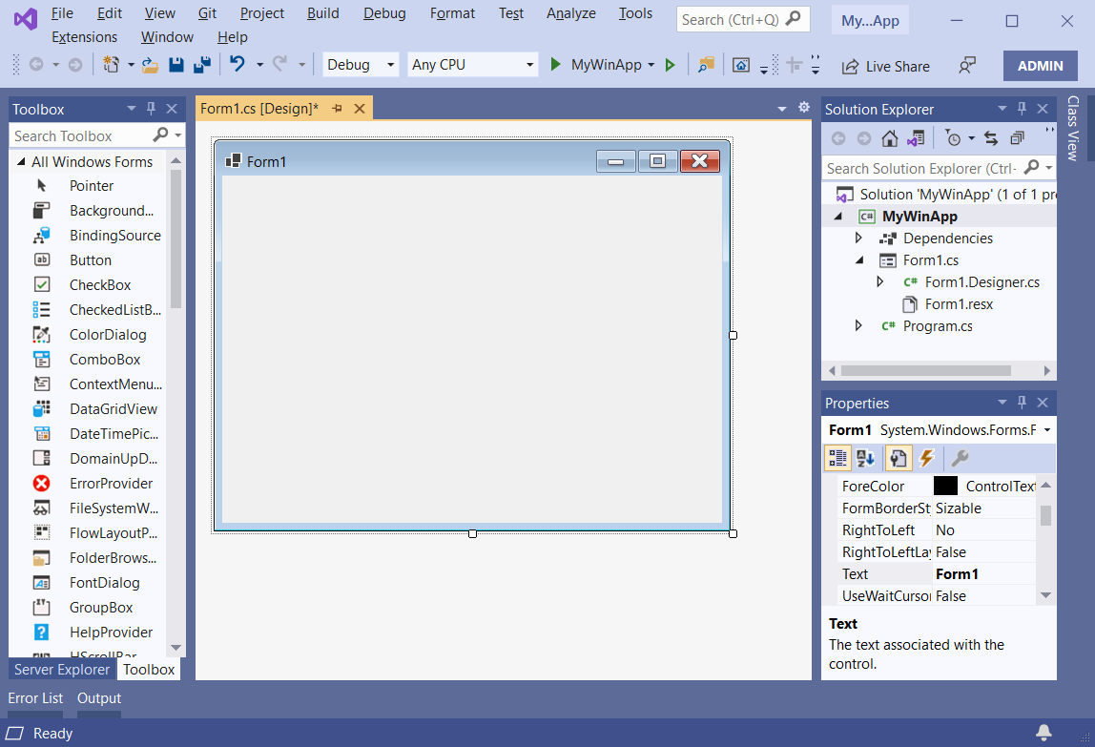

Slide 13
Working with Controls in WinForm

Slide 14
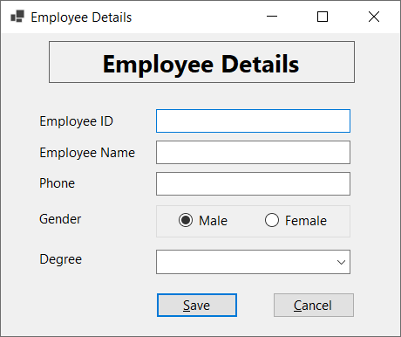
A Strategy for Designing the GUI
Identify needed controls / components
Isolate regions and behaviors
Sketch (phác hoạ) the GUI
Choose Layout managers
Requirements
Input data
Implement event handlers
Output Data
Operations

Slide 15
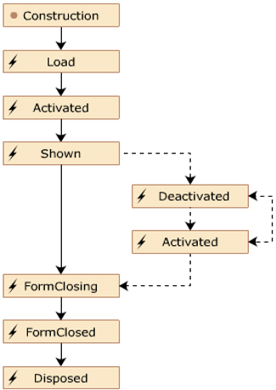
Forms Class
Is represented as a class in the System.Windows.Forms namespace
Is the basic unit of an application
Presents information to the user
Receives information from the user
Properties | Text, BackColor, ForeColor, Font, WindowState, AcceptButton, Location, Modal, Name
Methods | Activate, Close, Focus, Hide, Show, Enabled
Events | Load, Activated,Shown,Deactivate, FormClosing, FormClosed, Resize, Click, GotFocus

Slide 16
Types of Control
Base Control Class: The Control class is the base class for Windows Forms controls. It provides the infrastructure required for visual display in Windows Forms applications and provides the following capabilities:
Exposes a window handle. Manages message routing
Provides mouse and keyboard events, and many other user interface events
Provides advanced layout features
Composite Controls: A composite control is a collection of Windows Forms controls encapsulated in a common container. This kind of control is sometimes called a user control

Slide 17
Types of Control
Extended Controls: It is a control that is created by inheriting from any existing Windows Forms control. With this approach, we can keep all of the inherent functionality of a Windows Forms control, and then extend that functionality by adding custom properties, methods, or other features
Custom Controls: It is a control that is created by inheriting from Control class. The Control class provides all of the basic functionality required by controls, including mouse and keyboard handling events, but no control-specific functionality or graphical interface

Slide 18
Control Class
Control class: Base class of all controls available in WinForms
Properties
Method
Event
CanFocus
Controls
Enable
Name
Parent
TabIndex
Visible
Focus
GetNextControl
Hide
IsMNemonic
Select
Show
Click
ControlAdd
DoubleClick
Validating
Validated
KeyPress
Leave
LostFocus
MouseClick
Move

Slide 19
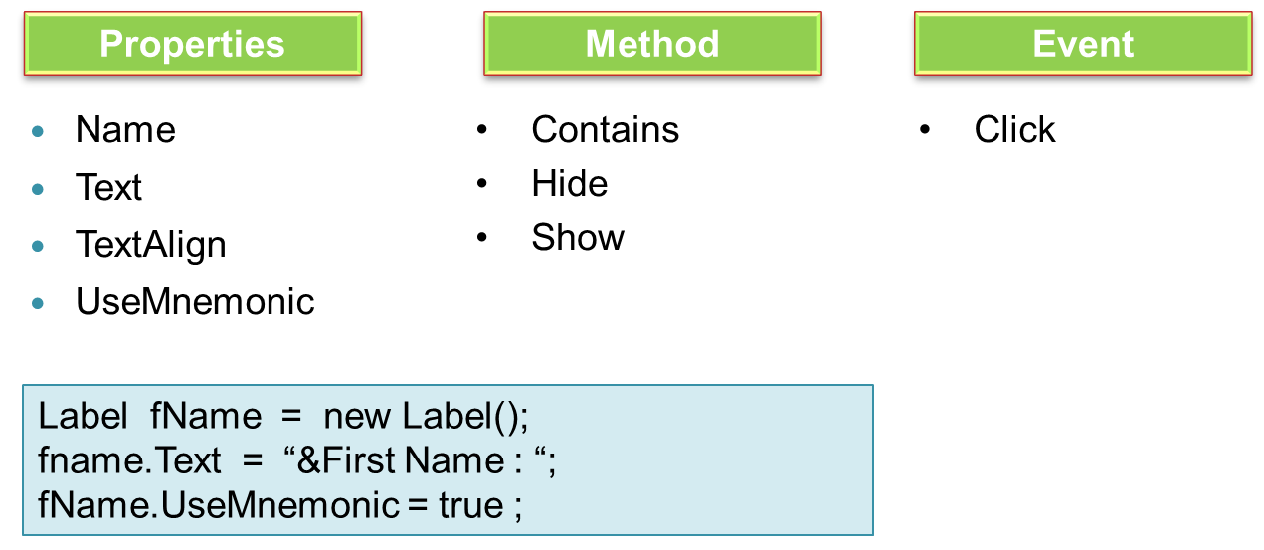
Label
Label controls are used to display text that cannot be edited by the user. They're used to identify objects on a form and to provide a description of what a certain control represents or does

Slide 20
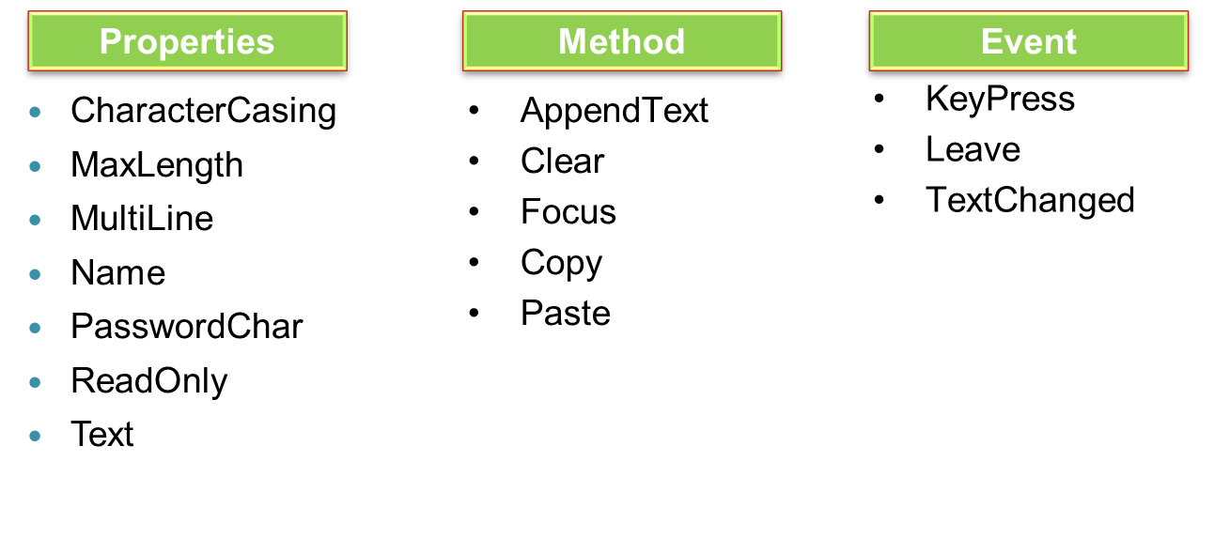
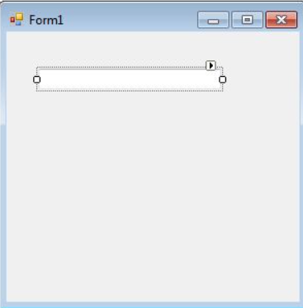
TextBox
A TextBox control accepts user input on a Form

Slide 21
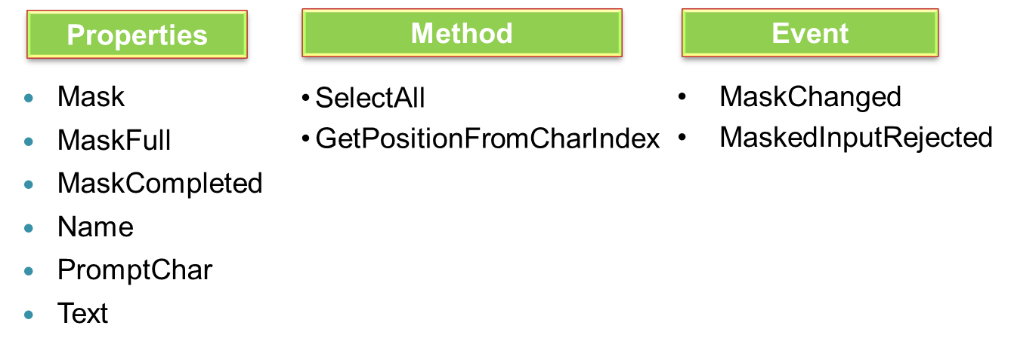
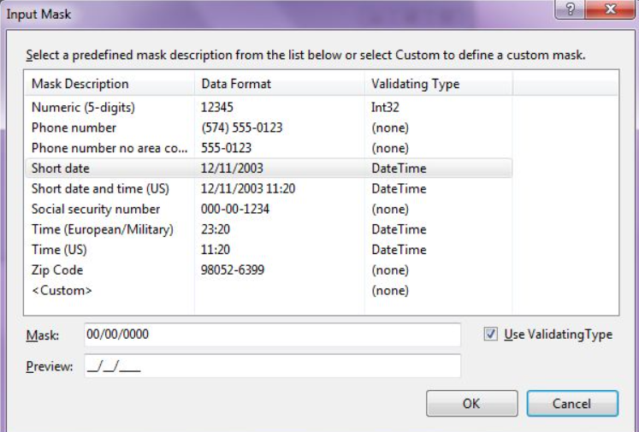
MaskedTextBox
A MaskedTextBox control provides a validation mechanism for user input on a Form. When we want a TextBox to accept a date in mm/dd/yyyy format, we can set masking in the MaskedTextBox

Slide 22
MaskedTextBox
Mask | Description
0 | Digit, required. [0-9]
9 | Digit or space, optional
# | Digit or space, optional. If this position is blank in the mask, it will be rendered as a space in the Text property. Plus (+) and minus (-) are allowed
L | Letter, required [a-zA-Z]
? | Letter, optional. [a-zA-Z]
& | Character, required. If the AsciiOnly property = true, behaves like the "L"
C | Character, optional. Any non-control character. If the AsciiOnly property =true, this element behaves like the "?" element
A | Alphanumeric, required. If the AsciiOnly property =true, the only characters it will accept are the ASCII letters a-z and A-Z
a | Alphanumeric, optional. If the AsciiOnly property is set to true, the only characters it will accept are the ASCII letters a-z and A-Z

Slide 23
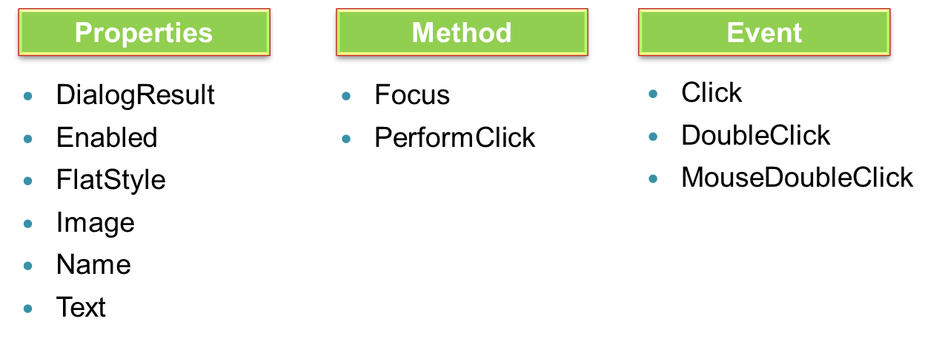
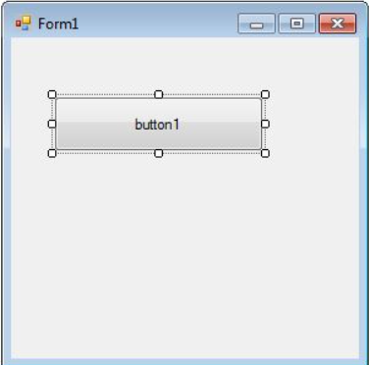
Button
A Button control is a child control placed on a Form and used to process click event and can be clicked by a mouse click or by pressing ENTER or ESC keys

Slide 24
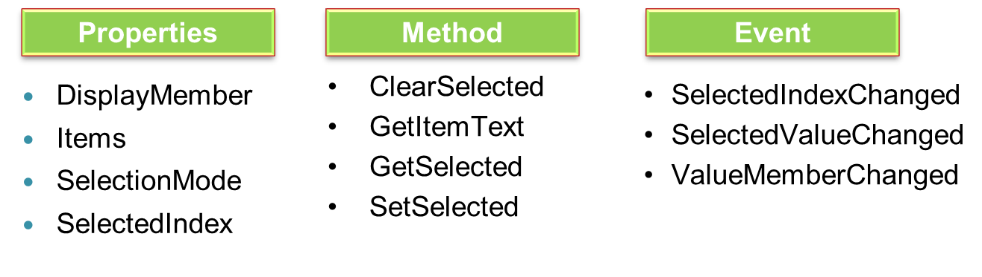
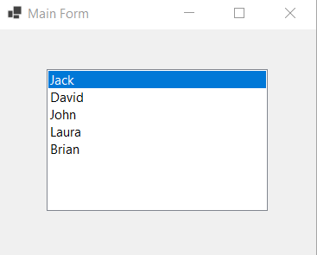
ListBox
A ListBox control provides a user interface to display a list of items. Users can select one or more items from the list
A ListBox may be used to display multiple columns and these columns may have images and other controls

Slide 25
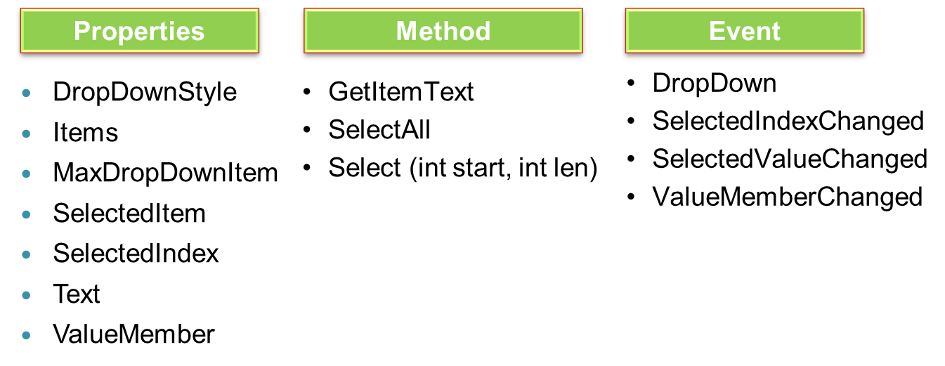
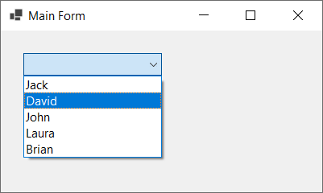
ComboBox
The ComboBox control provides combined functionality of a text box and a listbox in a single control. Only one list item is displayed at one time in a ComboBox and rest of the available items are loaded in a drop down list

Slide 26
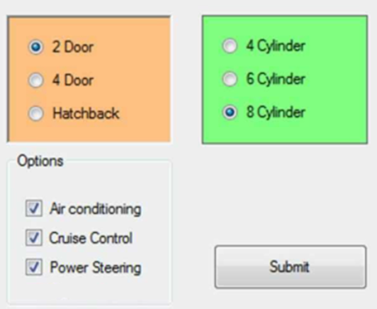
More Controls
Value Setting ControlForm class
RadioButton
CheckBox
CheckListBox
Grouping Controls
GroupBox
Panel
Images Control
PictureBox
ImageList

Slide 27
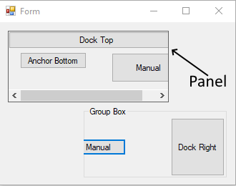
Grouping Control
GroupBox: Represents a Windows control that displays a frame around a group of controls with an optional caption
Panel: Used to group collections of controls.

Slide 28
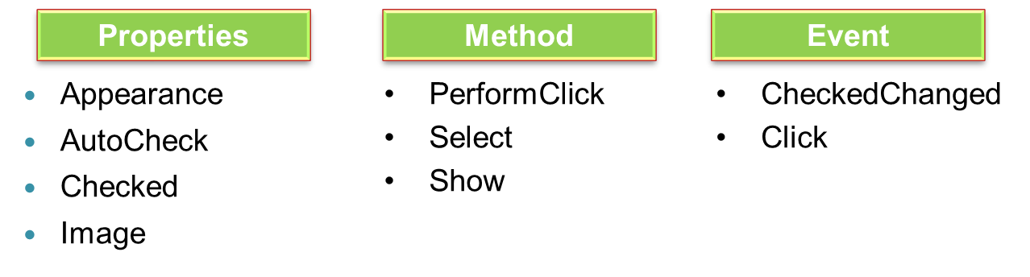
RadioButton
A RadioButton control provides a round interface to select one option from a number of options. Radio buttons are usually placed in a group on a container control, such as a Panel or a GroupBox, and one of them is selected

Slide 29
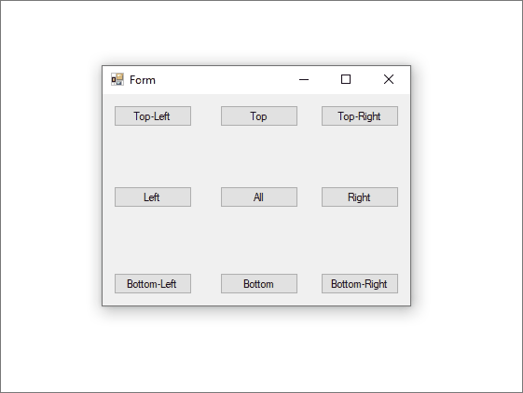
Position and Layout of Controls
Anchor: Anchoring a control allows us to tie the control to one or more sides of the parent container. As the container changes in size, any child control will maintain its distance to the anchored side

Slide 30
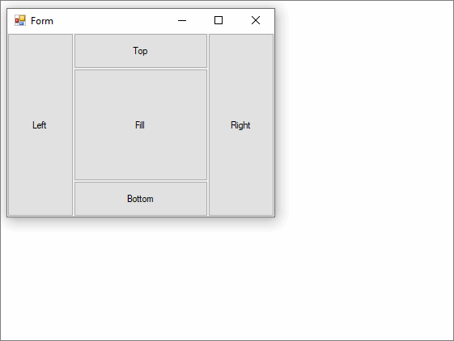
Position and Layout of Controls
Dock: The Dock property sets which border of the control is aligned to the corresponding side of the parent, and how the control is resized within the parent
When a control is docked, the container determines the space it should occupy and resizes and places the control. The width and height of the control are still respected based on the docking style

Slide 31
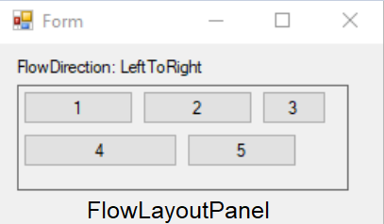
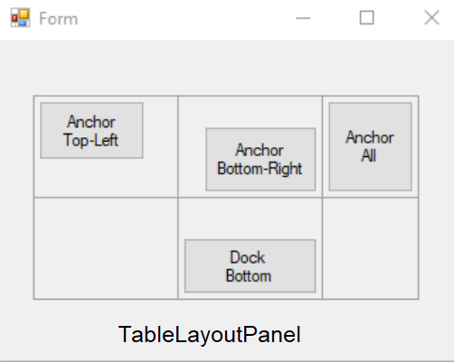
Position and Layout of Controls
Flow Layout: The FlowLayoutPanel control arranges its contents in a horizontal or vertical flow direction. We can wrap the control's contents from one row to the next, or from one column to the next
Table layout: The TableLayoutPanel control arranges its contents in a grid. Because the layout is done both at design time and run time, it can change dynamically as the application environment changes

Slide 32
Working with Controls Demonstration

Slide 33
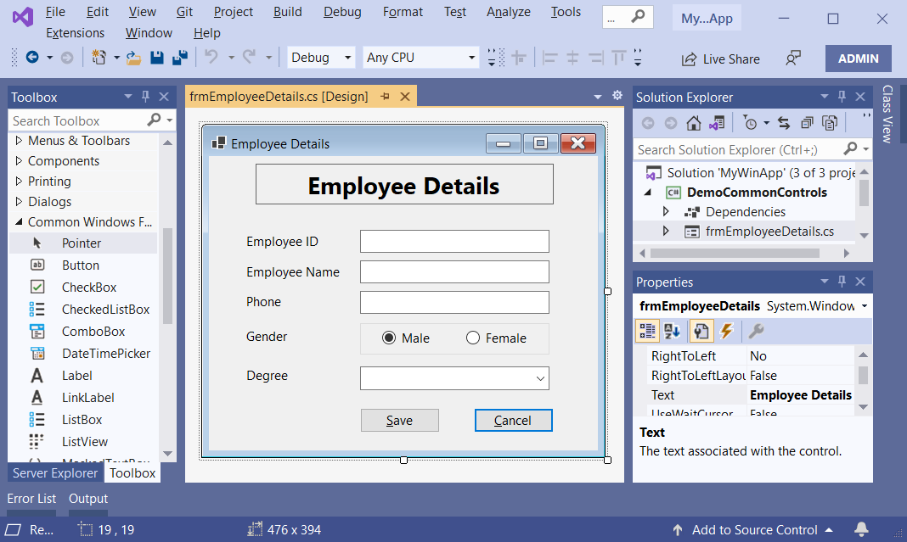
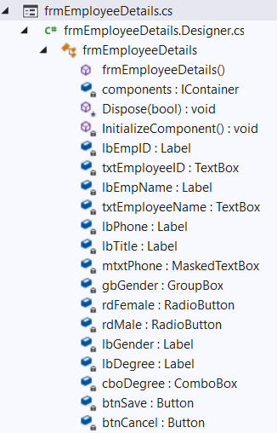
1.Create a WinForm app named DemoCommonControls which includes a form named frmEmployeeDetails as follows:

Slide 34
2.Design UI as the following description table:
Object Type | Object name | Properties | Event Handlers
Label | lbTitle | BorderStyle: FixedSingle ; Font:16.2pt, style=Bold
Label | lbEmpID | Text : Employee ID
Label | lbEmpName | Text : Employee Name
Label | lbPhone | Text: Phone
Label | lbGender | Text : Gender
Label | lbDegree | Text: Degree
TextBox | txtEmployeeID
TextBox | txtEmployeeName
MaskedTextBox | mtxtPhone | Mask: 000-0000000
GroupBox | gbGender

Slide 35
Object Type | Object name | Properties | Event Handlers
RadioButton | rdMale | Text: Male Checked: true
RadioButton | rdFemale | Text: Female
ComboBox | cboDegree | Text: ---Select Degree--- Items: Ph. D. Master Engineer Bachelor Technician
Button | btnSave | Text: &Save | Click
Button | btnCancel | Text: &Cancel | Click
Form | frmEmployeeDetails | Text: Employee Details; StartPosition: CenterScreen AcceptButton: btnSave CancelButton: btnCancel

Slide 36
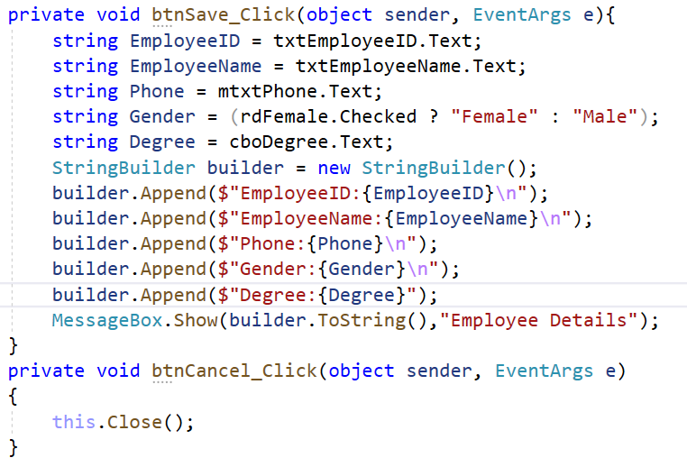
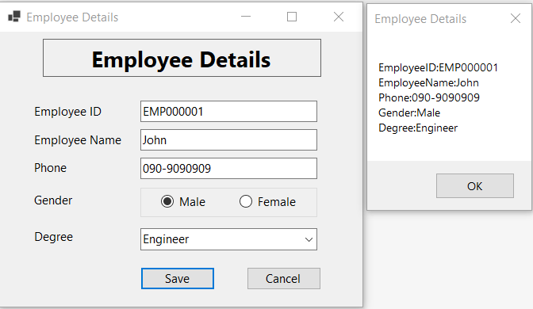
3.Write codes for frmEmployeeDetails.cs then run project:

Slide 37
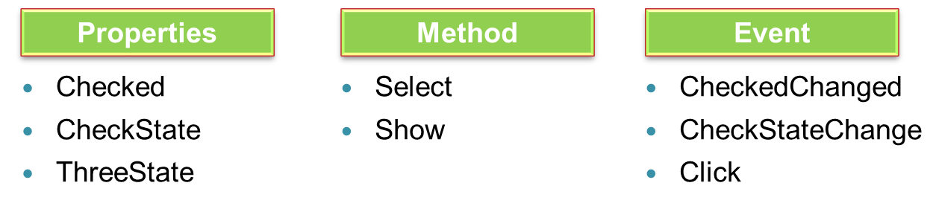
CheckBox
A CheckBox control allows users to select single or multiple items from a list of items

Slide 38
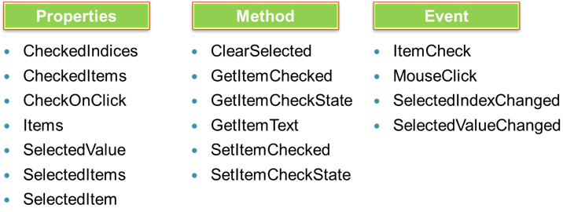
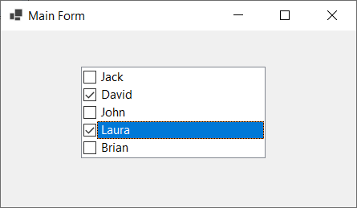
CheckedListBox
Displays a ListBox in which a check box is displayed to the left of each item

Slide 39
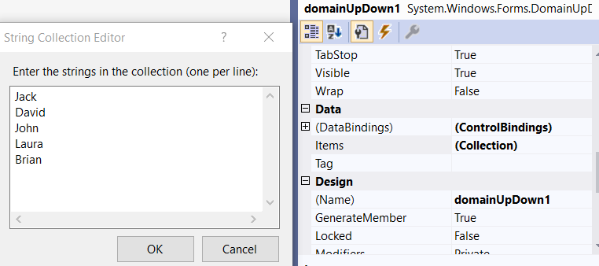
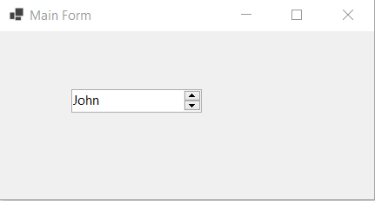
DomainUpDown
A DomainUpDown control allows users to provide a spin (up/down) interface to move through pre-defined strings using up and down arrows
Properties | Items, Wrap, ReadOnly SelectedItem, SelectedIndex
Methods | DownButton, UpButton
Events | SelectedItemChanged

Slide 40
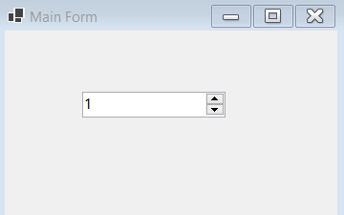
NumericUpDown
A NumericUpDown control allows users to provide a spin (up/down) interface to move through pre-defined numbers using up and down arrows
Properties | Increment,Maximum,Minimum,Value DecimalPlaces ThousandsSeperator
Methods | DownButton UpButton
Events | ValueChanged

Slide 41
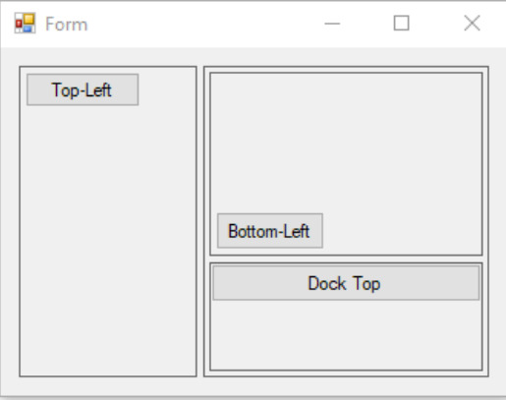
SplitContainer
The SplitContainer control can be thought of as a composite control. It's two panels separated by a movable bar. When the mouse pointer is over the bar, the pointer changes shape to show that the bar is movable

Slide 42
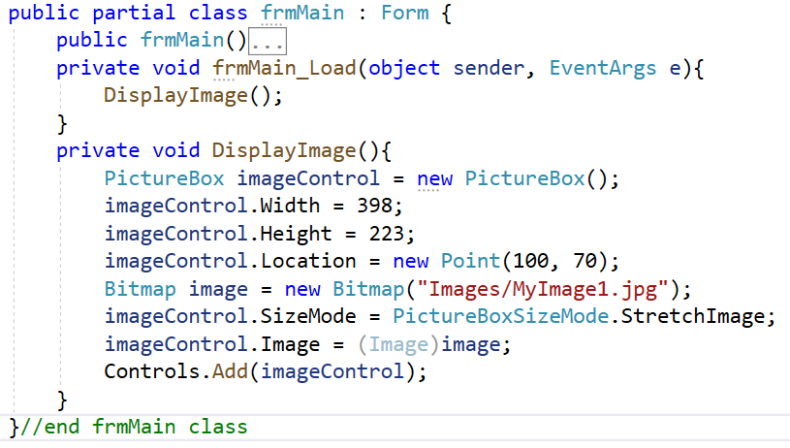
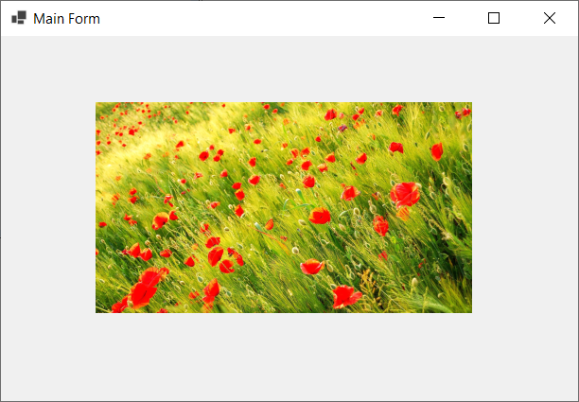
PictureBox
PictureBox control is used to display images in Windows Forms
Properties | Image, ErrorImage, InitialImage, SizeMode
Methods | Load, LoadAsync
Events | Click, Leave, LoadCompleted

Slide 43
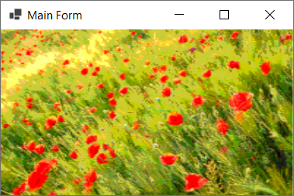
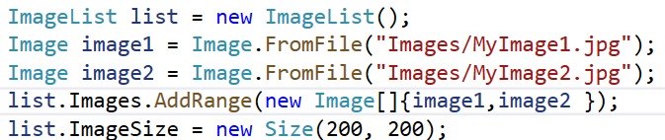
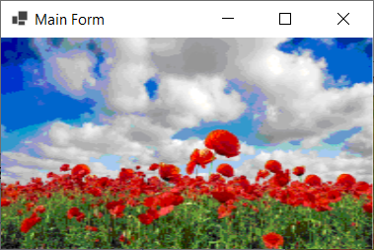
ImageList
Provides methods to manage a collection of Image objects
Properties | Images, ColorDepth, ImageSize, Name
Methods | Draw
Events | RecreateHandle

Slide 44
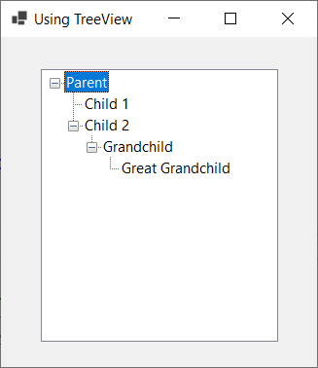
TreeView
Used for displaying data in a hierarchical maner
Has three types of nodes : Root, Parent and Leaf
Properties | Nodes, TopNode, SelectedNode, ShowPlusMinus, ShowRootLines
Methods | CollapseAll, ExpandAll, GetNodeAt, GetNodeCount
Events | NodeMouseClick, ItemDrag, AfterCollapse, AfterExpand, AfterSelect

Slide 45
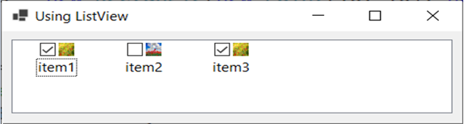
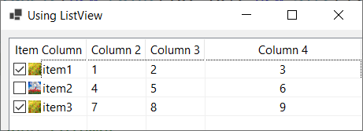
ListView
Used to display a collection of items in a list. The ListView control is an ItemsControl that is derived from ListBox
Types of ListView: Tile, List, Details, SmallIcon, LargeIcon
Properties | Columns, Items, View, MultiSelect, Sort, SelectedItems, SelectedIndices
Methods | GetItemAt, Clear, ArrangeIcons
Events | ColumnClick, SelectedIndexChanged, ItemCheck, ItemSelectionChanged

Slide 46
DataGridView
The DataGridView control provides a powerful and flexible way to display data in a tabular format
We can use the DataGridView control to show read-only views of a small amount of data, or we can scale it to show editable views of very large sets of data
The DataGridView control supports display and edit tabular data from many different kinds of data sources. Binding data to the DataGridView control is straightforward and intuitive, and in many cases it is as simple as setting the DataSource property

Slide 47
DataGridView
The DataGridView control supports the standard Windows Forms data binding model, so it will bind to instances of classes described in the following list:
Any class that implements the IList interface, including one-dimensional arrays
Any class that implements the IListSource interface, such as the DataTable and DataSet classes
Any class that implements the IBindingList interface, such as the BindingList<> class
Any class that implements the IBindingListView interface, such as the BindingSource class

Slide 48
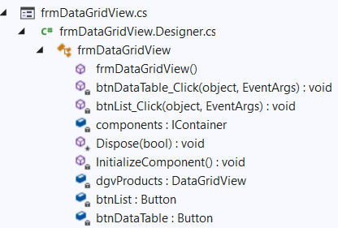
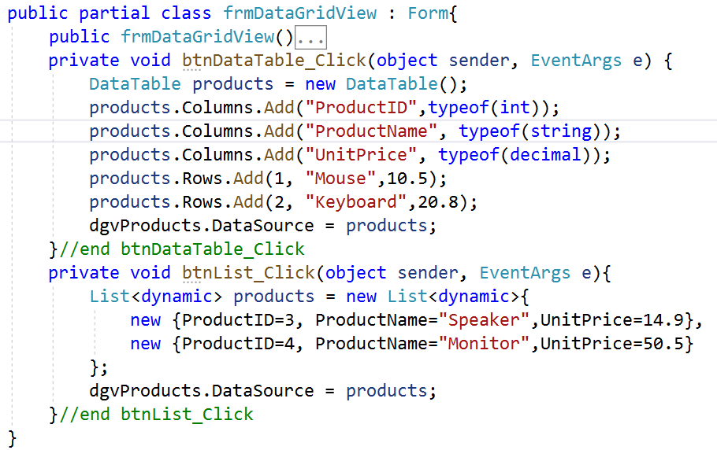
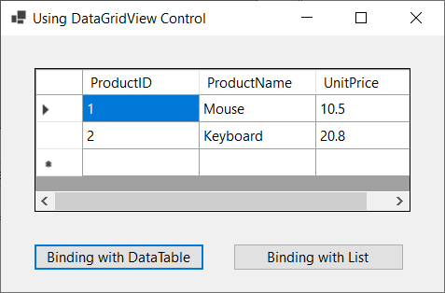
DataGridView

Slide 49
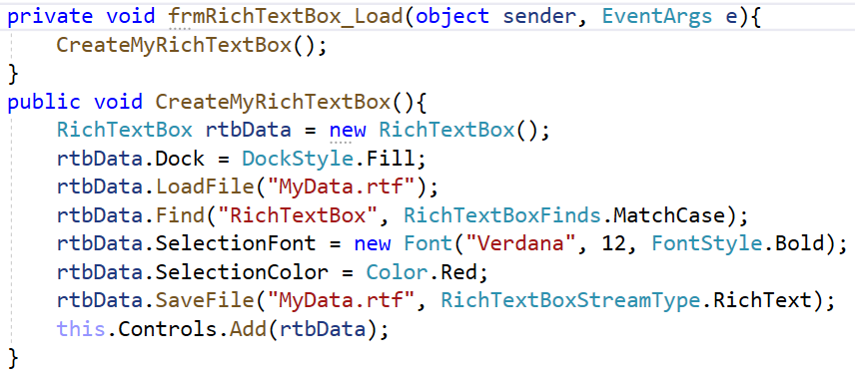
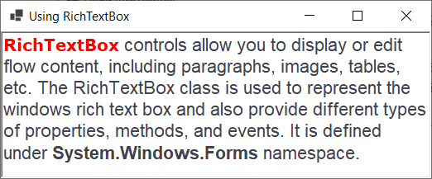
RichTextbox
RichTextBox control is a textbox that gives us rich text editing controls and advanced formatting features also includes loading rich text format (RTF) files
Properties | Font, ScrollBars, SelectedText, SelectionFont, SelectionLength, Text, WordWrap
Methods | AppendText, Copy, Paste, Redo, Undo
Events | Click, HScroll, Vscroll, SelectionChanged

Slide 50


ProgressBar
A ProgressBar control is used to represent the progress of a lengthy operation that takes time where a user must wait for the operation to be finished
Properties | Maximum; Minimum; Step; Style; Value
Methods | Increment, PerformStep

Slide 51


DateTimerPicker
The Windows Forms DateTimePicker control allows the user to select a single item from a list of dates or times
Properties | Format, MinDate, MaxDate, ShowCheckBox, Value, CustomFormat
Methods | Focus, Show
Events | Click, FormatChanged, ValueChanged

Slide 52


Timer
The Timer class in C# represents a Timer control that executes a code block at a specified interval of time repeatedly
Properties | Enable, Interval
Methods | Start, Stop
Events | Tick

Slide 53
MenuStrips
Common UI elements that may be contained within a MenuStrip:
ToolStripMenuItem: A traditional menu item
ToolStripComboBox: An embedded ComboBox
ToolStripSeparator: A simple line that separates content
ToolStripTextBox: An embedded TextBox
When the ampersand character (&) is placed before a letter in a menu item, it denotes the item’s shortcut key. In this example, we are creating &File and E&xit; therefore, the user may activate the Exit menu by pressing Alt+F, and then X

Slide 54


MenuStrips Demonstration
Create a WinForm app named MyApp which includes a form named frmMain then writes codes as follows:

Slide 55



MenuStrips Demonstration

Slide 56
Multiple-Document Interface(MDI) Application
Multiple-document interface (MDI) applications enable you to display multiple documents at the same time, with each document displayed in its own window
The foundation of a Multiple-Document Interface (MDI) application is the MDI parent form. This is the form that contains the MDI child windows, which are the sub-windows wherein the user interacts with the MDI application
MDI applications follow a parent form and child form relationship model. MDI applications allow us to open, organize, and work with multiple documents at the same time by opening them under the context of the MDI parent form
MDI applications often have a Window menu item with submenus for switching between windows or documents

Slide 57



MDI Application Demonstration
1.Create a WinForm app named MyMDIApp which includes a form named frmMain
2.On the frmMain, set the "IsMdiContainer" property to True (the default value is False). Notice that the background color of the form has changed to dark gray
3.On the MyMDIApp project, right-click, and select Add | Form(Windows form) named frmChildForm and click Add then design user interface as follows :
3
2
1

Slide 58

MDI Application Demonstration
4.Write codes for frmMain.cs then run project:

Slide 59


MDI Application Demonstration

Slide 60
Lab and Assigment
1. Do Hands-on Lab: Lab_01_AutomobileManagement_Using_LINQ and WinForms.pdf 2. Do Assigment: Assignment_01_MemberManagement.pdf

Slide 61
Summary
Concepts were introduced:
Overview Windows Forms (WinForm)
Explain about type Controls and Components in WinForm
Working with Common Controls: Label, TextBox, MaskedTextBox,etc
Working with Menu, ProgressBar and Timer in WinForm
Explain about Position and Layout in WinForm
Demo create Windows Forms Application
Demo creating and using Menu in WinForm
Demo create MDI Application in WinForm

